Slide 1
Power System Planning
Prof. Dr. Muhammad Kamran
Lecture No. 7
mkamran@uet.edu.pk

Slide 2
Contents
Design of sub Transmission lines for given area
Types of Distribution substations

Slide 3
Introduction (Chap-4)
In broad definition, the distribution system is that part of the electric system between the bulk power source and customers service switches
The definition of the distribution system includes the following components;
1- Sub transmission system
2- Distribution substation
3- Distribution or primary feeders
4- Distribution transformers
5- secondary circuits
6- Service drops

Slide 4
Sub transmission
Sub transmission system is that part of electric utility system which delivers power from bulk power sources such as large transmission substations
The sub transmission circuits may be made of overhead open wire construction on wood or steel poles or of underground cables
Voltage of these circuits varies from 12.7 to 245 kV with majority at 69, 115 and 138 kV
There is continuous trend in usage of higher voltages as a result of increasing use of higher primary voltages

Slide 5
The sub transmission system designs varies from simple radial system to sub transmission network
The major consideration affecting the design are cost and reliability
In Radial system circuit radiates from the bulk power stations to the distribution substations
It is simple and has low first cost but has low service continuity
Instead an improved radial type sub transmission design is preferred
It allows faster service restoration in case of fault occurrence

Slide 6
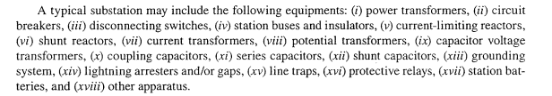
Distribution substations
Distribution substation design has been somewhat standardized by the electric utility industry based on past experiences
standardization is a continuous process

Slide 7
Design aspects
The First Step in designing a Substation is to design an Earthing and Bonding System
The function of an earthing and bonding system is to provide an earthing system connection to which transformer neutrals or earthing impedances may be connected in order to pass the maximum fault current
The earthing system also ensures that no thermal or mechanical damage occurs on the equipment within the substation, thereby resulting in safety to operation and maintenance personnel.

Slide 8
In designing the substation, three voltages have to be considered.
1. Touch Voltage: This is the difference in potential between the surface potential and the potential at an earthed equipment whilst a man is standing and touching the earthed structure
2. Step Voltage: This is the potential difference developed when a man bridges a distance of 1m with his feet while not touching any other earthed equipment
3. Mesh Voltage: This is the maximum touch voltage that is developed in the mesh of the earthing grid

Slide 9
Earthing Materials
1. Conductors: Bare copper conductor is usually used for the substation earthing grid
The copper bars themselves usually have a cross-sectional area of 95 square millimetres, and they are laid at a shallow depth of 0.25-0.5m, in 3-7m squares
In addition to the buried potential earth grid, a separate above ground earthing ring is usually provided, to which all metallic substation plant is bonded
2. Connections: Connections to the grid and other earthing joints should not be soldered because the heat generated during fault conditions could cause a soldered joint to fail
Joints are usually bolted, and in this case, the face of the joints should be tinned

Slide 10
3. Earthing Rods: The earthing grid must be supplemented by earthing rods to assist in the dissipation of earth fault currents and further reduce the overall substation earthing resistance
These rods are usually made of solid copper, or copper clad steel.
4. Switchyard Fence Earthing: The switchyard fence earthing practices are possible and are used by different utilities. These are:
(i) Extend the substation earth grid 0.5m-1.5m beyond the fence perimeter
The fence is then bonded to the grid at regular intervals. (ii) Place the fence beyond the perimeter of the switchyard earthing grid and bond the fence to its own earthing rod system
This earthing rod system is not coupled to the main substation earthing grid.

Slide 11
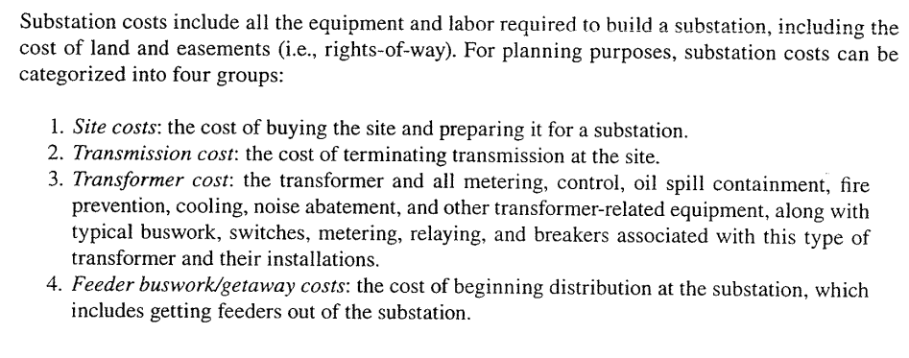
Substation cost

Slide 12
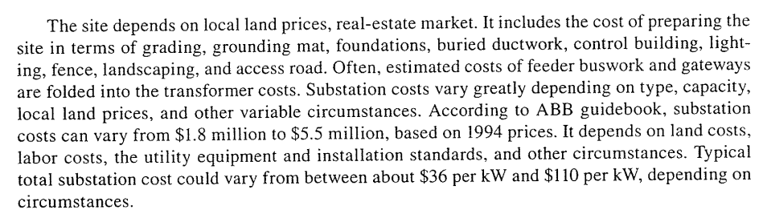

Slide 13
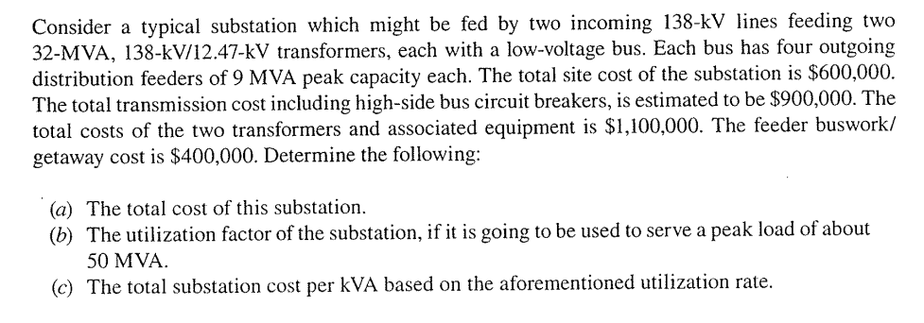
Example

Slide 14
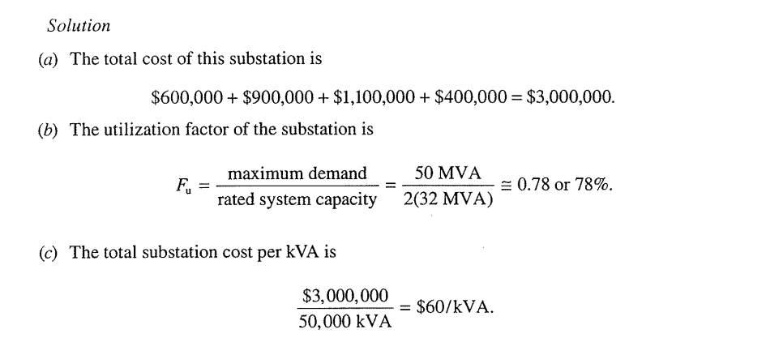

Slide 15
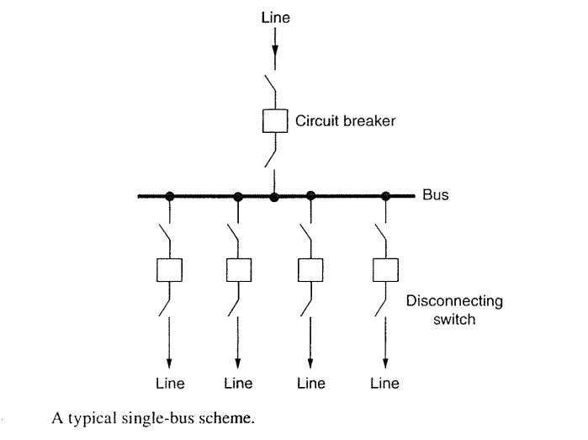
Substation Bus schemes

Slide 16
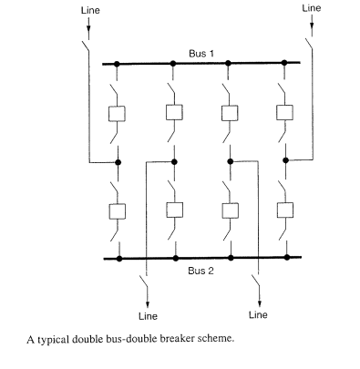

Slide 17
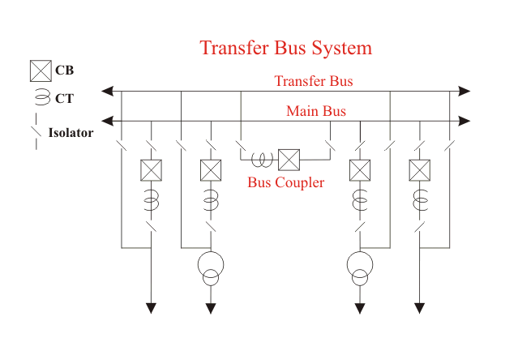

Slide 18
This is an alternative of a double bus system
The main conception of Main and Transfer Bus System is, here every feeder line is directly connected through an isolator to a second bus called transfer bus
The said isolator in between transfer bus and feeder line is generally called bypass isolator.
The main bus is as usual connected to each feeder through a bay consists of the circuit breaker and associated isolators at both sides of the breaker
There is one bus coupler bay which couples transfer bus and main bus through a circuit breaker and associated isolators at both sides of the breaker.

Slide 19
If necessary, the transfer bus can be energized by main bus power by closing the transfer bus coupler isolators and then breaker
Then the power in transfer bus can directly be fed to the feeder line by closing the bypass isolator
If the main circuit breaker associated with the feeder is switched off or isolated from the system, the feeder can still be fed in this way by transferring it to transfer bus

Slide 20
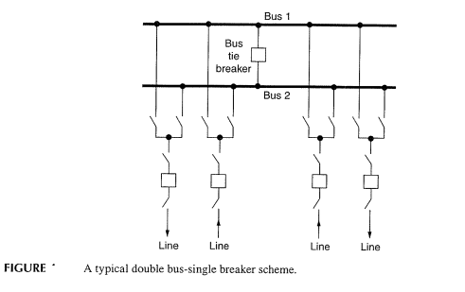

Slide 21
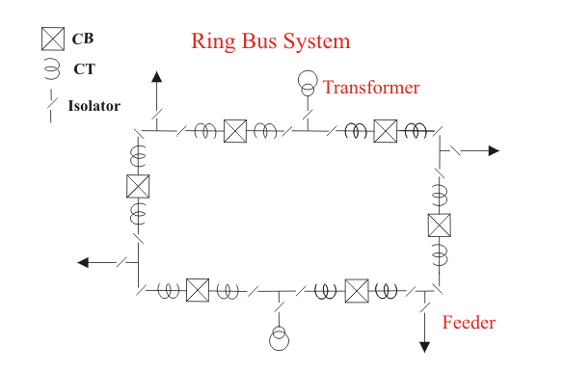

Slide 22
The schematic diagram of the system is given in the figure
It provides a double feed to each feeder circuit, opening one breaker under maintenance or otherwise does not affect supply to any feeder
But this system has two major disadvantages
One as it is a closed circuit system it is next to impossible to extend in future and hence it is unsuitable for developing systems
Secondly, during maintenance or any other reason, if any one of the circuit breaker in ring loop is switched off, the reliability of system becomes very poor as because closed loop becomes opened

Slide 23
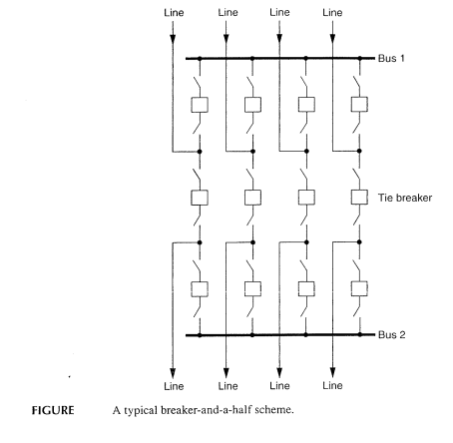

Slide 24
Breaker and Half scheme
This is an improvement on the double breaker scheme to effect saving in the number of circuit breakers
For every two circuits, only one spare breaker is provided. The protection is however complicated since it must associate the central breaker with the feeder whose own breaker is taken out for maintenance
As shown in the figure that it is a simple design, two feeders are fed from two different buses through their associated breakers, and these two feeders are coupled by a third breaker which is called tiebreaker

Slide 25
Normally all the three breakers are closed, and power is fed to both the circuits from two buses which are operated in parallel
The tiebreaker acts as a coupler for the two feeder circuits
During the failure of any feeder breaker, the power is fed through the breaker of the second feeder and tiebreaker, therefore each feeder breaker has to be rated to feed both the feeders, coupled by the tiebreaker

Slide 26
Advantages of One and A Half Breaker Bus System
During any fault on any one of the buses, that faulty bus will be cleared instantly without interrupting any feeders in the system since all feeders will continue to feed from other healthy bus.
Disadvantages of One and a Half Breaker Bus System
This scheme is much expensive due to investment for third breaker.

Slide 27
Substation components
Circuit Breakers
Current Transformers
Isolators
Power Transformers
The following clearances should be observed
VOLTAGE LEVEL | MINIMUM GROUND CLEARANCE
less than 66kV | 6.1m
66kV - 110kV | 6.4m
110kV - 165kV | 6.7m
greater than 165kV | 7.0m
:

Slide 28
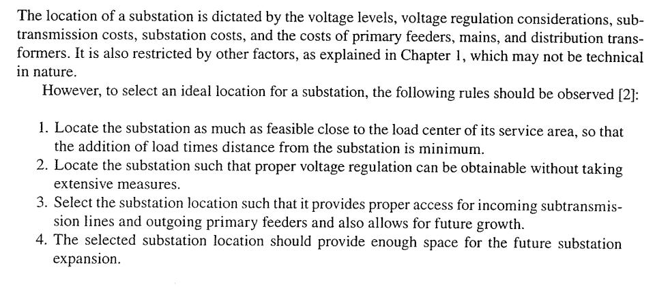
Substation location

Slide 29
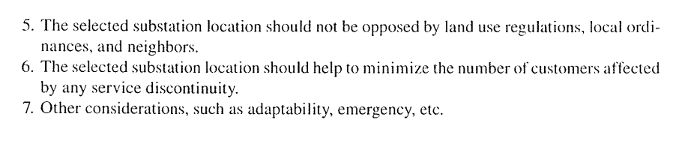

Slide 30
Rating of Distribution substation
The additional capacity requirements of a system with increasing load density can be met by;
1- Either holding the service area of a given substation constant and increasing its capacity
2- or developing new substation and thereby holding the rating of the given substation constant
It is helpful to assume that the system changes (i) at constant load density for short term distribution planning and (ii) at increasing load density for long term planning

Slide 31
Analysis of Substation
Substation is analyzed as square shape scenario representing a part of service area or full service area
Assume square area is served by four primary feeders from central feeder point
Each feeder and its laterals are of three phase Dots represent balanced three phase loads lumped at that location and fed by distribution transformers

Slide 32
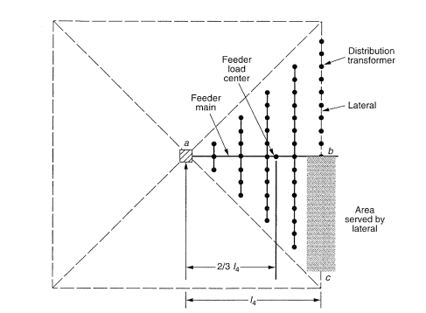

Slide 33
Percentage voltage drop from the feed point “a” to the end of last lateral at “C” is ;
Vd_{ac} = Vd_{ab} + Vd_{bc}
A simplified voltage drop calculation is made introducing constant K which can be defined as percent voltage drop per Kilo volt ampere-mile
Fig gives K-constant for various voltages and copper conductor sizes
Same fig is developed for three phase overhead lines with an equivalent spacing of 37 inches between phase conductor

Slide 34
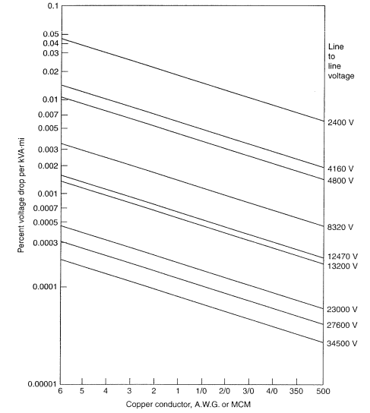
K- constant for copper conductor, with load power factor 0.9

Slide 35
The following analysis is based on the work done by researchers and each feeder serves a total load of;
S₄= A₄ X D kVA from previous diagram, where S₄ is kilovoltampere load served by one of four feeders emanating from a feed point, A₄ is the area served by one of four feeders emanating from a feed point in (mi²) and D is load density-kVA/ mi²

Slide 36
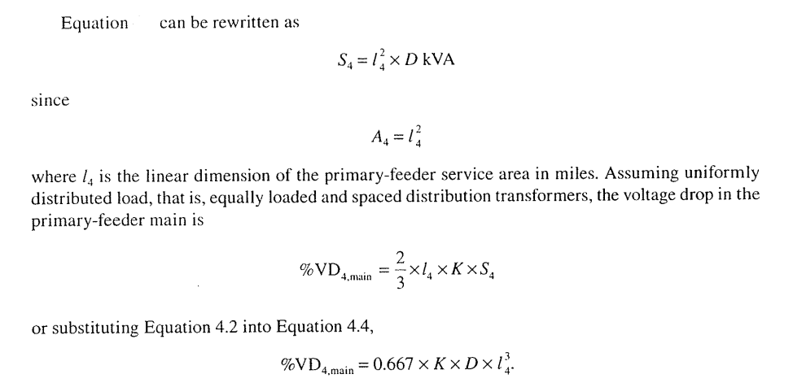

Slide 37
It is assumed that the total or lumped sum load is located at a point on the main feeder at a distance of 2/3 x l4 from the feeder point a
Researcher extends the discussion to hexagonally shaped service area supplied by six feeders from the feed point which is located at the center as shown in fig assuming that each service area is equal to one –sixth of the hexagonal shaped total area or in next slide

Slide 38
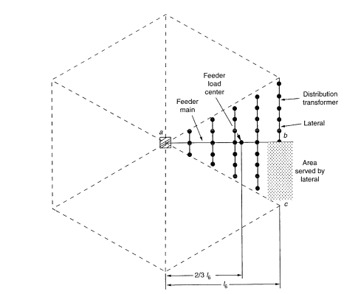

Slide 39
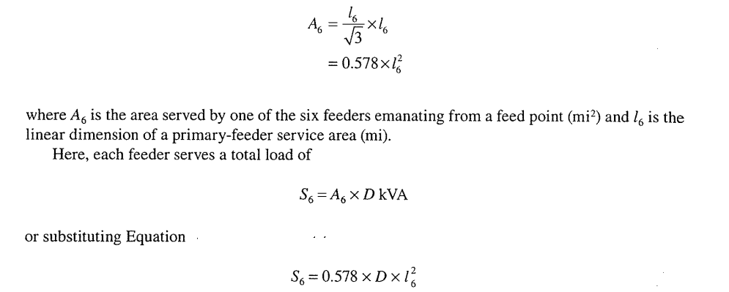

Slide 40
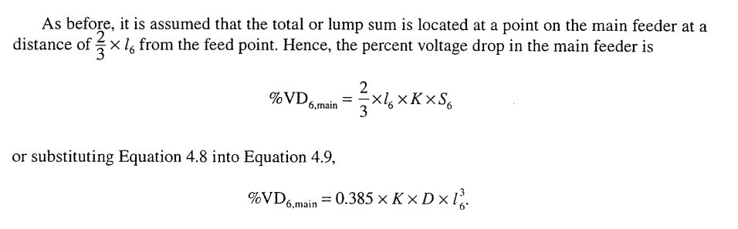

Slide 41
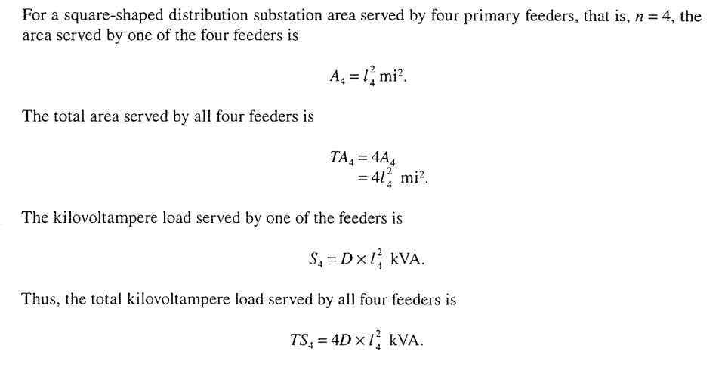
Comparison of the Four and Six feeder Patterns

Slide 42
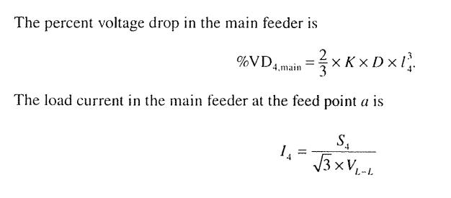
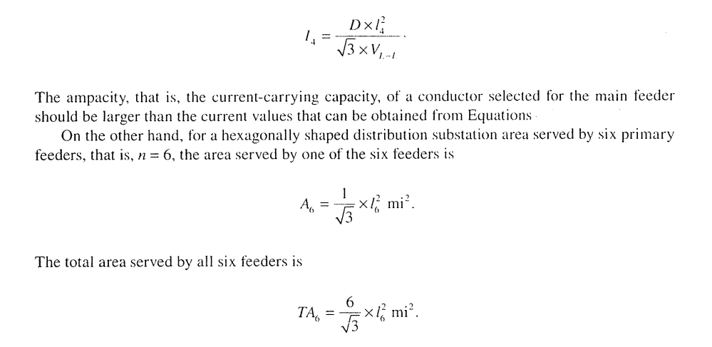

Slide 43
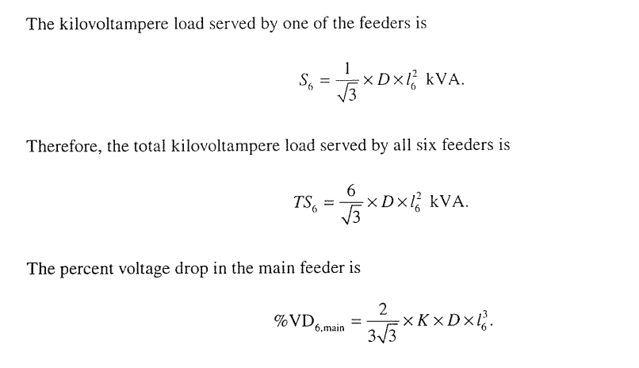

Slide 44
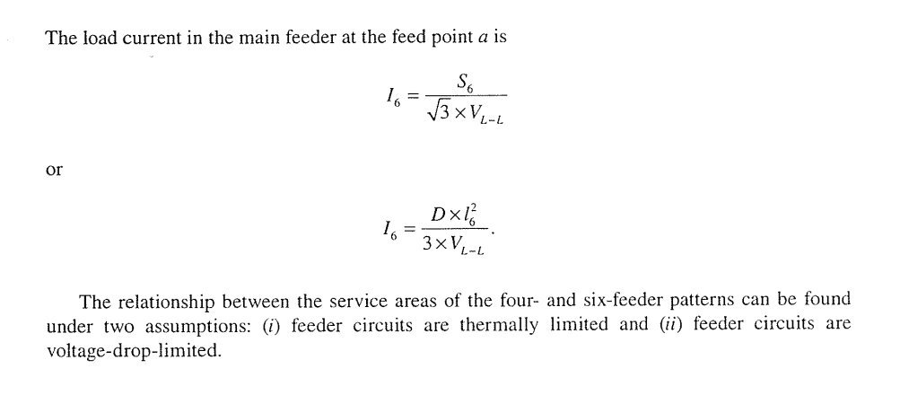

Slide 45
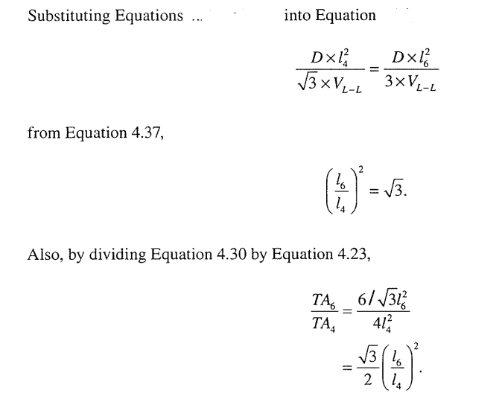
For Thermally Limited feeders
For given conductor size and neglecting voltage drop, I4=I6;

Slide 46
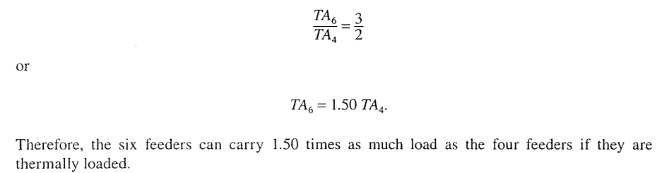

Slide 47
For voltage drop limited feeder circuits
Assuming same voltage drop % VD₄= %VD₆
%Vd₄=2/3 K.D.I₄^{3,} %Vd₆=2/3 / 1.73 K.D.I₆³
^{Equating Vd}₄ ^{and Vd}₆
l₄= 0.833 I₆
TA₆= 6/sqrt (3) X l₆²
Since TA₄= 4 x I₄²
TA₄ = 4x (0.833)²l₆²
=2.78 l₆²

Slide 48
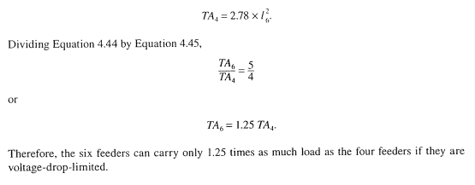

Slide 49
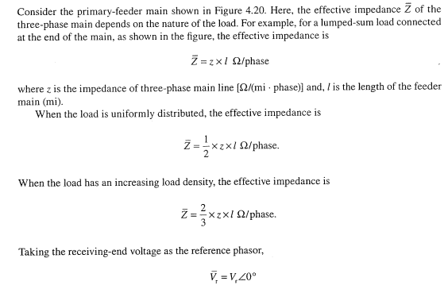
Derivation of K Constant

Slide 50
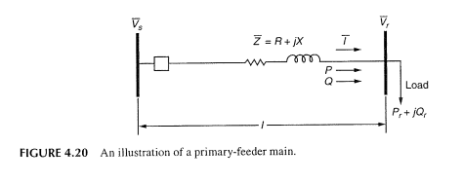

Slide 51
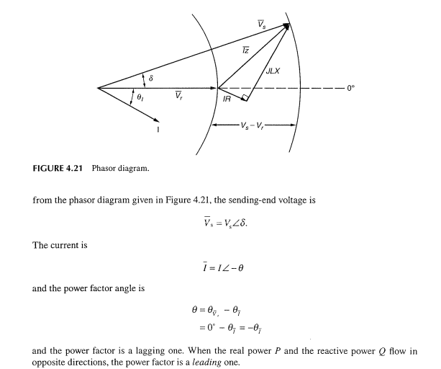

Slide 52
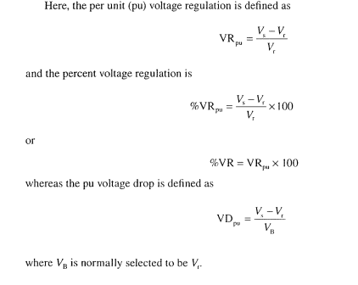

Slide 53
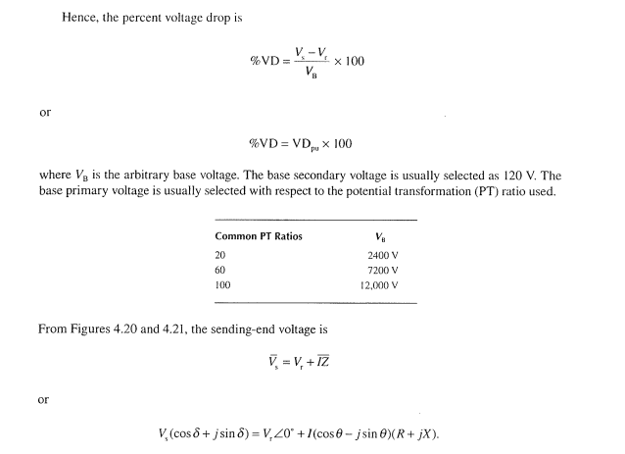

Slide 54
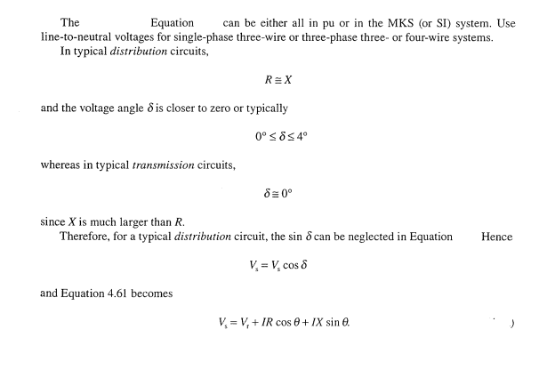

Slide 55
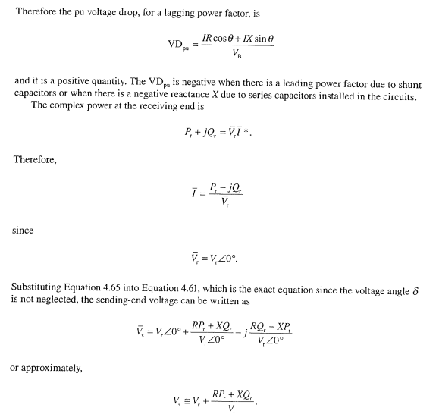

Slide 56
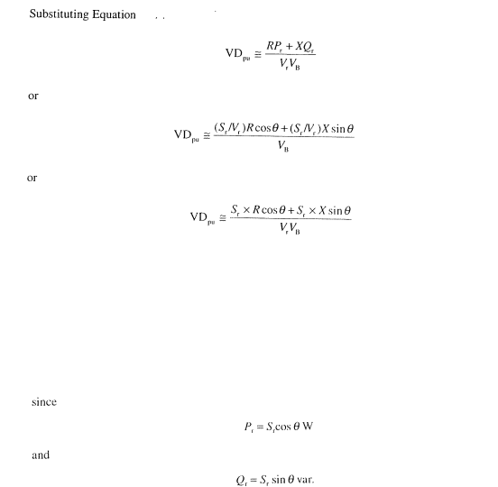

Slide 57
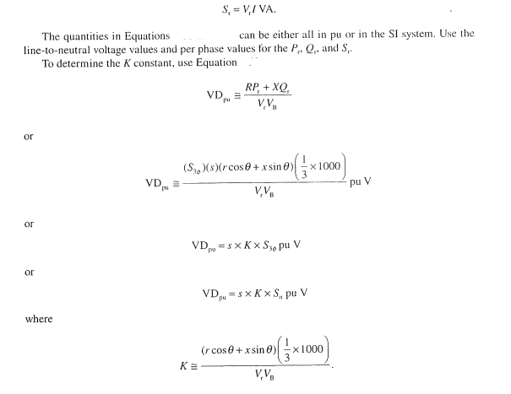

Slide 58
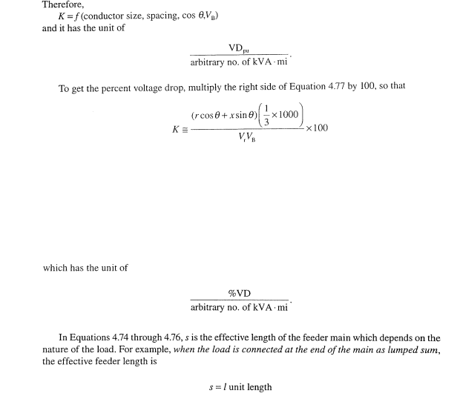

Slide 59
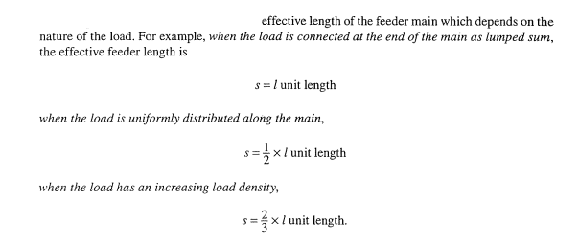

Slide 60
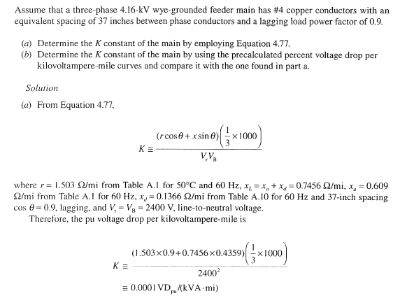
Example

Slide 61
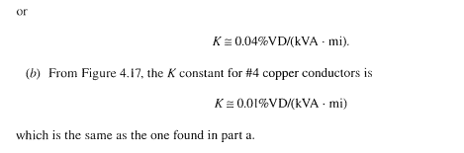

Slide 62
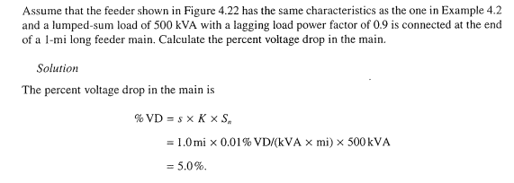
Example

Slide 63
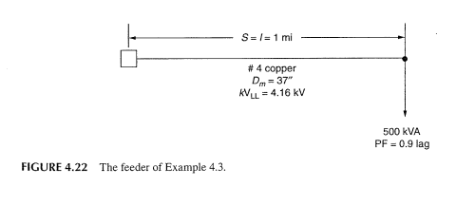

Slide 64
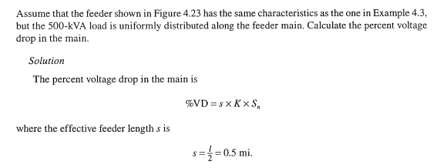

Slide 65
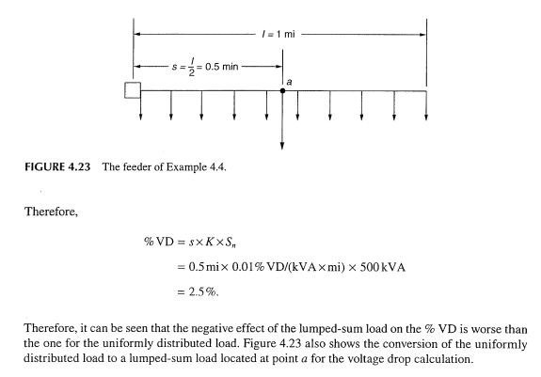

Slide 66
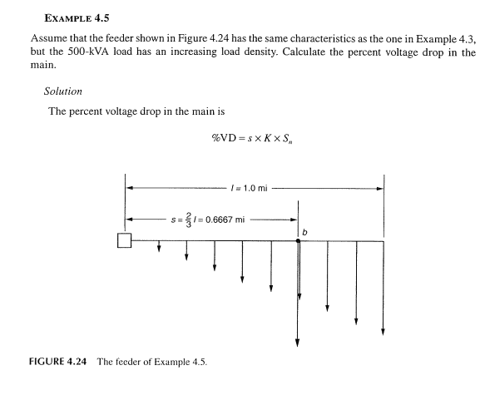

Slide 67
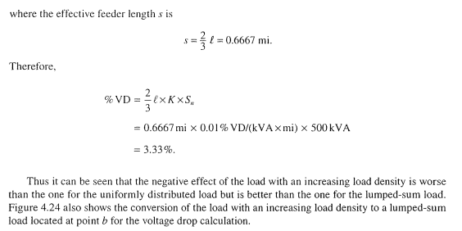

Slide 68
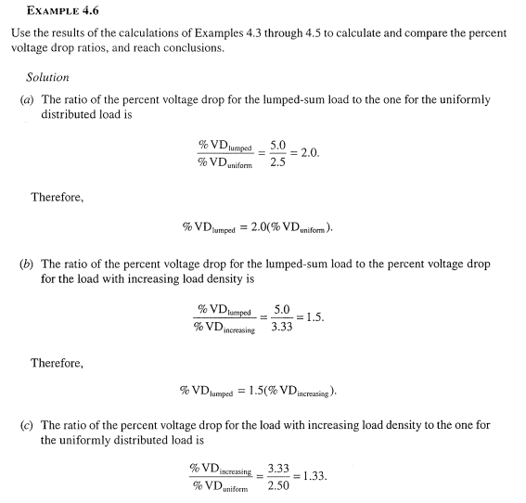

Slide 69
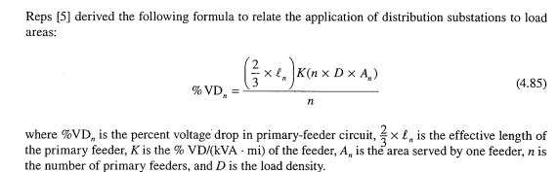
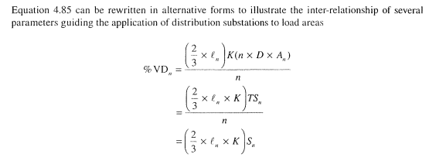
Percent voltage drop formula interpretation

Slide 70
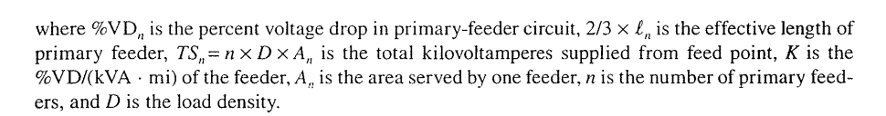

Slide 71


Slide 72



Slide 73

Example

Slide 74

Solution
Let From specs and size of conductor, max current = 230 amp

Slide 75


Slide 76


Slide 77


Slide 78

Substation size
Max load /feeder= Sn= D X l₄²
= 4 X 750 = 3000 kVA

Slide 79
Next Lecture
Calculations and SCADA

